Slide 1




ChIP-seq: method introduction
Elizabeth Permina
OGBF, University of Otago 2017
With the support of:

Slide 2
Analysis types
RNA-Seq
DNA-Seq
Genome assembly
Genome variation
Gene regulation and chromatin structure
Metagenomic studies

Slide 3

What is ChIP-Seq
Technology basics:
Antibodies and immunoprecipitation
How are regulatory sites structured
Library prep steps overview
Notes:
Immunoprecipitation (IP) is the technique of precipitating a protein antigen out of solution using an antibody that specifically binds to that particular protein. This process can be used to isolate and concentrate a particular protein from a sample containing many thousands of different proteins.

Slide 4
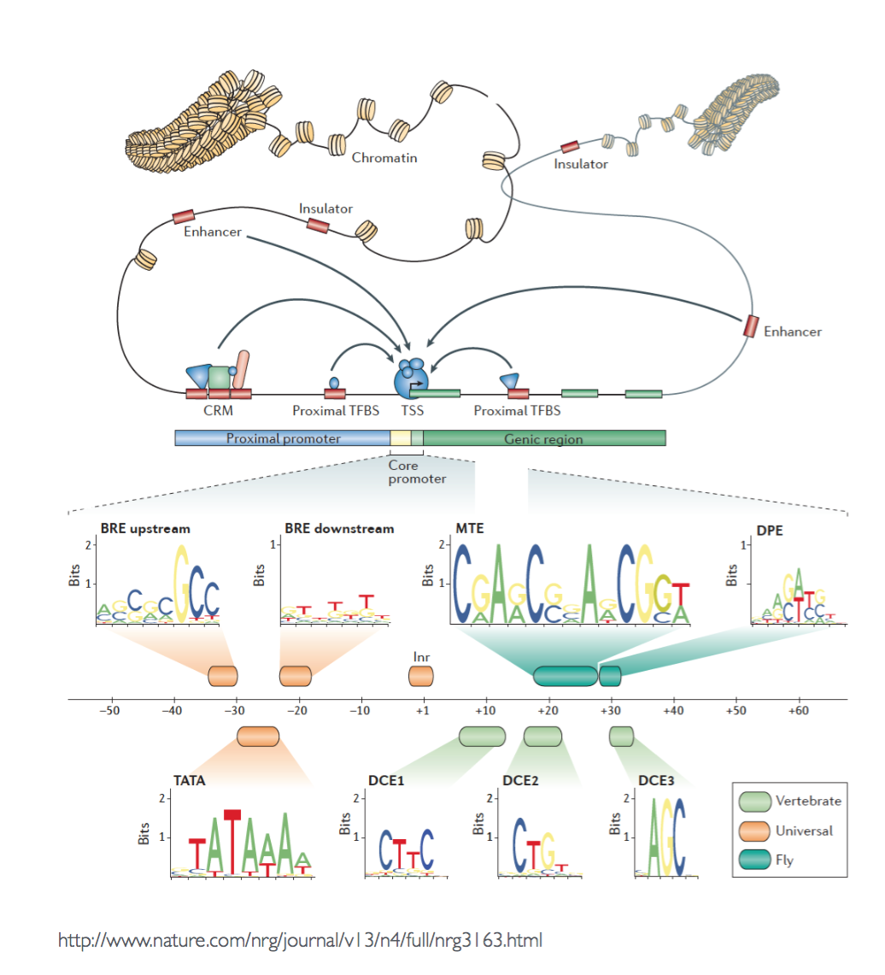
Notes:
RNA pol II promoter

Slide 5
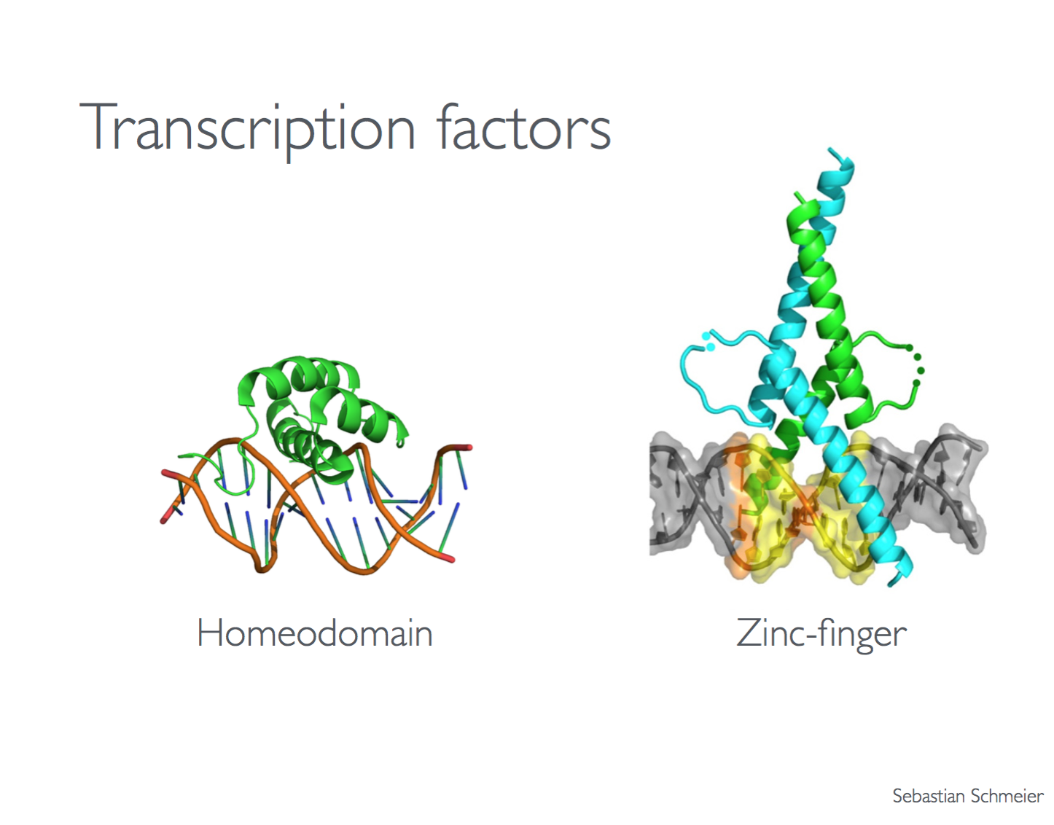
Transcriptional factors

Slide 6
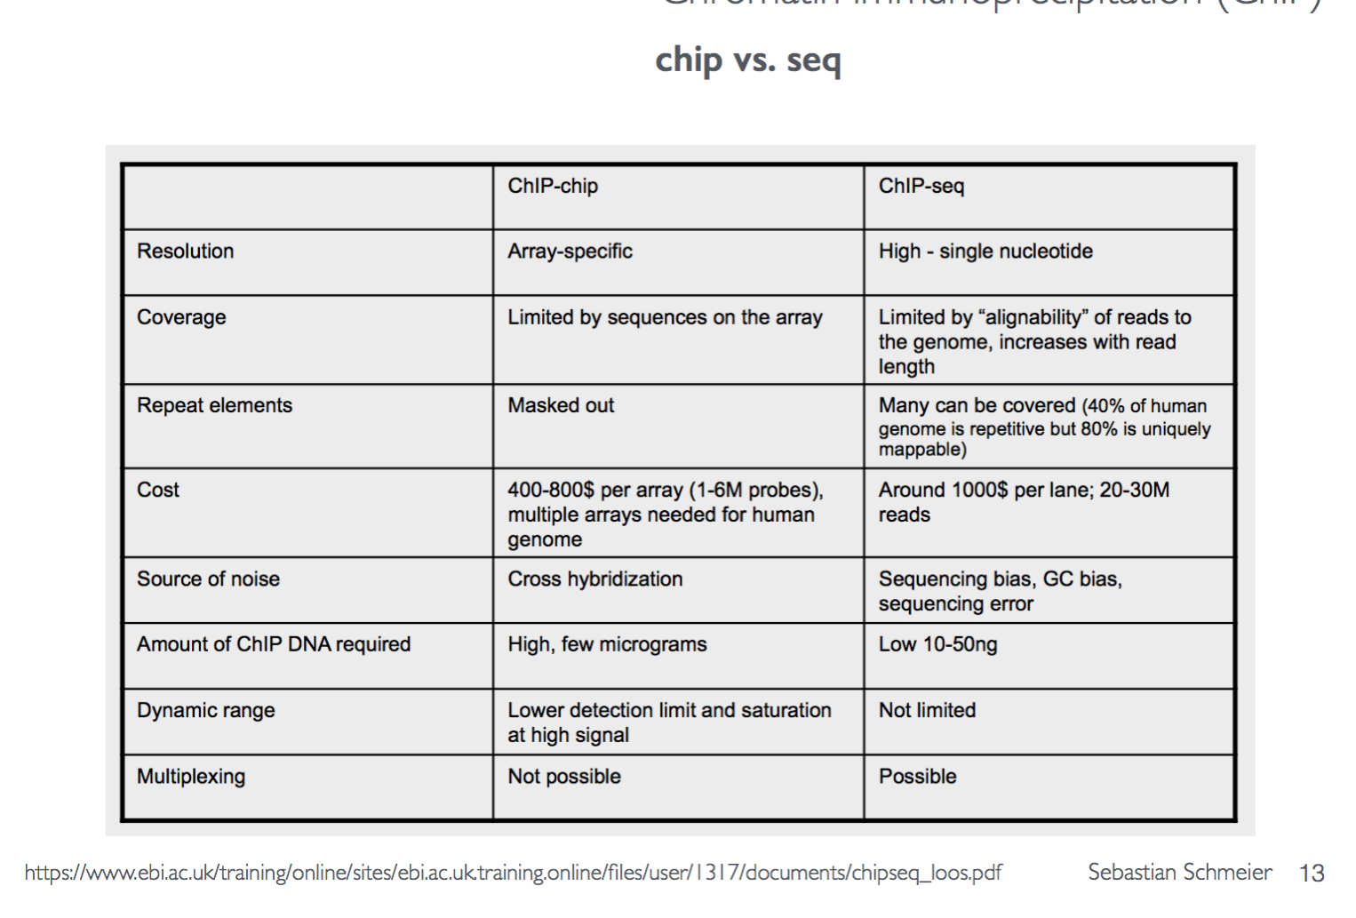
ChIP-chip
ChIP-seq
Lieb, 2001 proposed to combine ChIP with microarray
Limitations – low number of reference genomes
Any platform (Wold 2008)
Mostly Illumina
> 3000 papers mentions
Notes:
How ChIP-chip worked (Lieb, 2001)
How ChIP-seq works (Barski, 2007, Johnson, 2007)

Slide 7
What can you do with ChIP-seq?
Antoni Hurtado, et al. performed knock-down of the FoxA1 “pioneer factor”, resulting in reduced binding by the estrogen receptor (ER) at over 50% of known ER binding sites. They showed that FoxA1 is an important regulator of ER-mediated transcription, suggesting it may be a new and important therapeutic target in breast cancer (Hurtado 2011).
Dominic Shmidt, et al. used ChIP-seq to investigate the evolution of transcription factor binding. They focused on CEBPA and HNF4 binding in the liver tissue of five vertebrate species: human, mouse, dog, opossum and chicken. ChIP-chip would have been almost impossible given the different species involved and complexities in designing probes (Schmidt 2010).
Examples taken from https://bitesizebio.com/13541/an-introduction-to-chip-seq/
Notes:
What is possible with ChIP-seq?

Slide 8
ChIP-selected DNA fragments
Sequencing
FASTQ files
Alignment to the reference
Reference sequence
Peak calling (MACS2)
Downstream analysis*

Slide 9
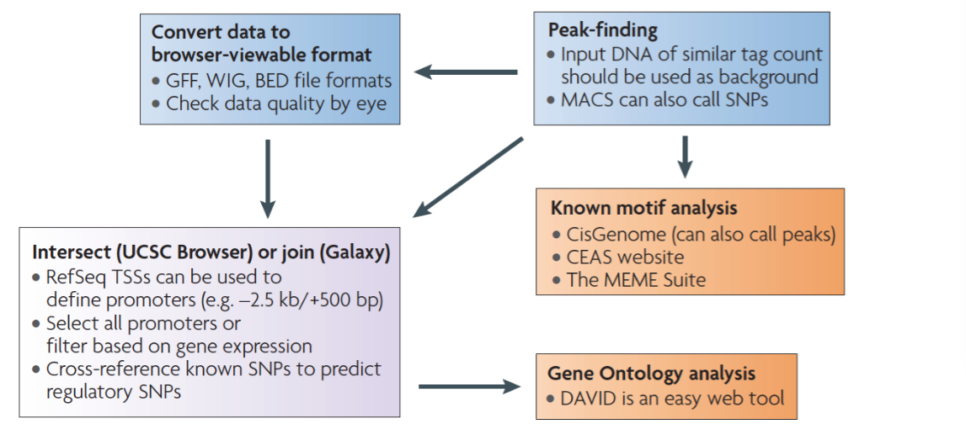

Slide 10
Peak calling
Basic - regions are scored by the number of tags in a window of a given size.
Each region is assessed by enrichment over control and minimum tag density.
Advanced - take advantage of the directionality of the reads.

Slide 11
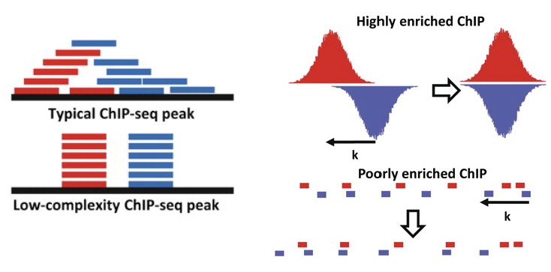
@ http://homes.soic.indiana.edu/

Slide 12
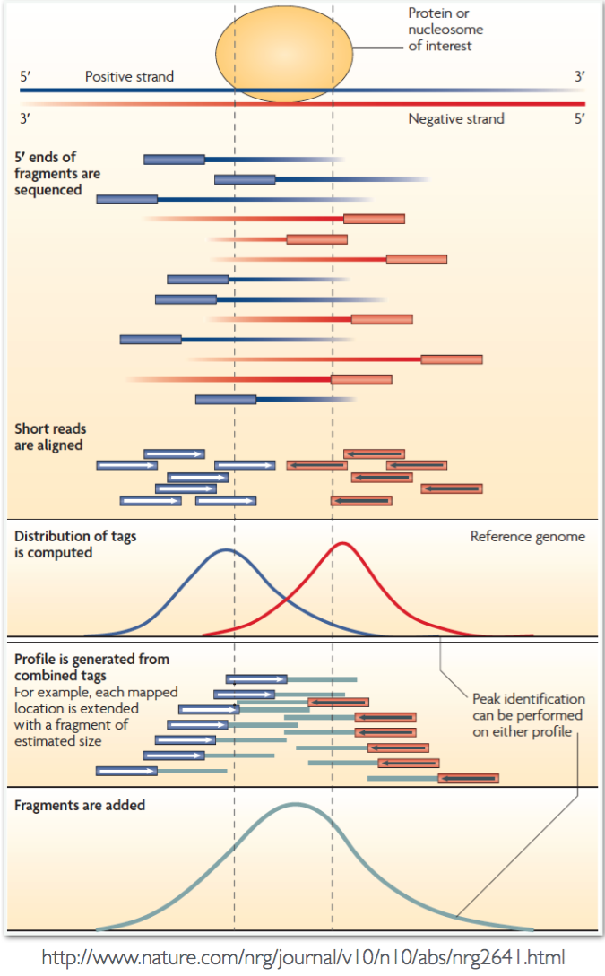
Challenges
Adjust for sequence alignability - regions that contain repetitive elements have different expected tag count
Different ChIP-seq applications produce different type of peaks. Most current tools have been designed to detect sharp peaks (TF binding, histone modifications at regulatory elements)

Slide 13
Experimental design
Multiplexing
PE sequence
Control type
Input controls
Mock IP – DNA obtained from IP without antibody (inconsistent)
Nonspecific IP
Replication

Slide 14
Experimental design
Control experiments
Open chromatin regions are fragmented more easily than closed regions
Uneven distribution of sequence tags across the genome
Some fraction of the peaks in the ChIP-seq signal map to a TF might be due the the nature of the chromatin structure in regions of open chromatin
A peak should be compared with the same region in a matched control

Slide 15
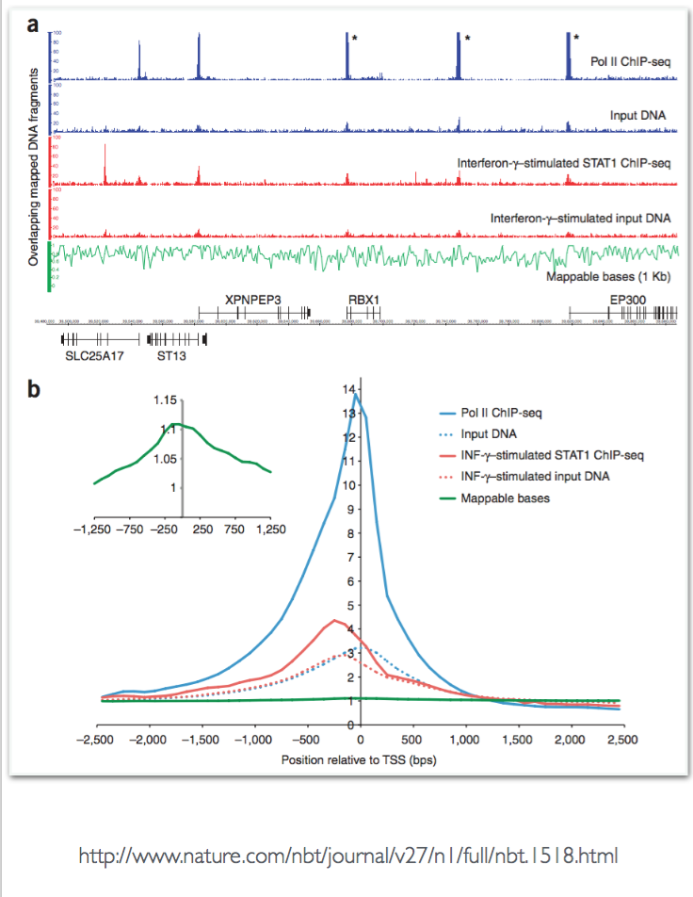
Controls

Slide 16
Experimental design
Antibody quality
A sensitive and specific antibody will give a high level of enrichment
Limited efficiency of antibody is one of the main reasons for failed ChIP-seq experiments
Check ahead, for example do a Western blot to check the reactivity of the antibody with unmodified non-histone proteins

Slide 17
Experimental design
Sequencing depth
More prominent peaks
Number of putative target regions increase

Slide 18
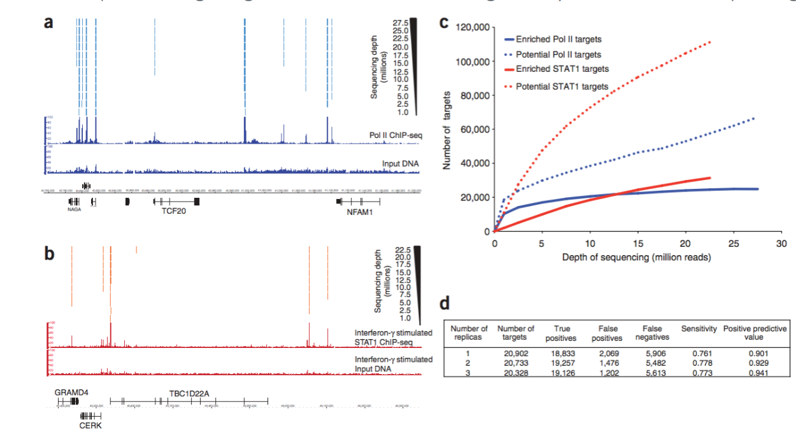
Experimental design – depth:

Slide 19
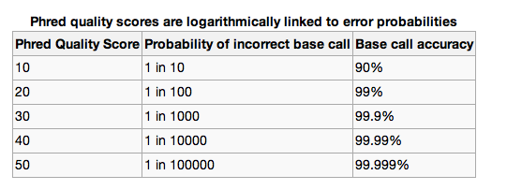
Data QC

Slide 20
Data QC
FastQC
Trimmomatic
SolexaQA package (trimming and length sorting)

Slide 21
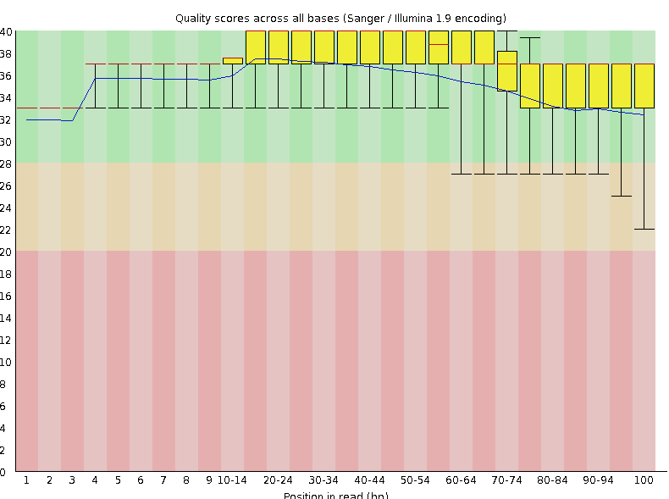
Data QC
Per base quality

Slide 22
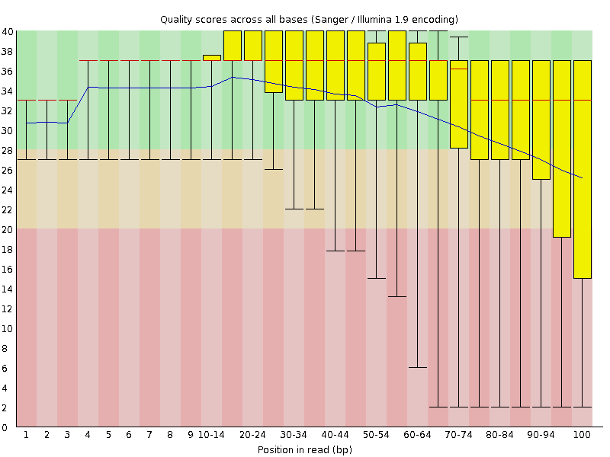
Data QC
Per base quality

Slide 23
Mapping challenges
Large amount of reads?
Large genome – needs indexing
Shorter read length
Mismatches
Repetitive regions
Multi-mapping (ambiguous) reads

Slide 24
Mapping reads
Align your reads to the unmasked genome
For ChIP-seq, usually short reads are used (36bp)
Limited gain in using longer reads
Exclude multimappers!

Slide 25
Data analysis overview

Slide 26
GREAT
GREAT predicts functions of cis-regulatory regions
Based on the function of the genes that are close to the peak region
http://bejerano.stanford.edu/great/public/html/

Slide 27
How to find a new motifs
Algorithmic motif search
Motif prediction
MEME - http://meme-suite.org/
ChIPmunk http://autosome.ru/chipmunk/

Slide 28
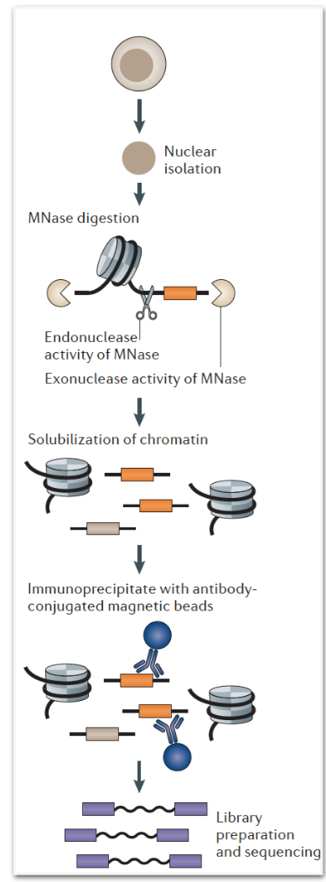
ORGANIC
In the occupied regions of genomes from affinity- purified naturally isolated chromatin (ORGANIC) method, soluble chromatin extracted from MNase treatment of nuclei is used as an input to ChIP
The input sample provides a genome-wide footprinting of factors
ChIP pull-down provides a factor-specific map in a single experiment using a simple library preparation protocol
Highly-specific and identifies more binding sites with consensus motifs than previous X-ChIP studies

Slide 29
Motif comparison
MACRO-APE
PERFECTOS-APE
Useful when you compare two de-novo predicted motifs or estimating evolution between species

Slide 30
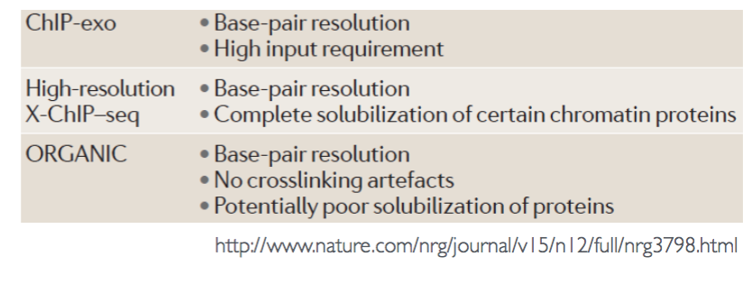
X-ChIP vs. native ChIP
Native ChIP is performed without crosslinking
It is usually applied to nucleosomes
The assumption being that the wrapping of DNA around histones precludes rearrangement during chromatin preparation and immunoprecipitation
It is often assumed that native ChIP is unsuitable for profiling non-histone proteins owing to potential rearrangement
Solubility of proteins of interest can also be an issue with native ChIP
As harsh detergents and sonication are not used, recovery might be
lower than for X-ChIP, especially for large complexes, in which case high-resolution X-ChIP is preferred
Notes:
Can be addressed by ORGANIC

